Slide 1
Authentication & Authorization Swapnil Patil

Slide 2
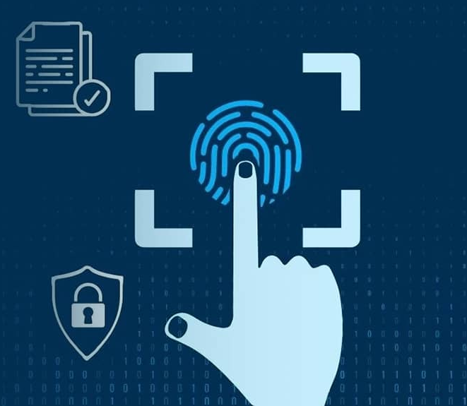
Authentication Authentication is the process that companies use to confirm that only the right people, services, and apps with the right permissions can get organizational resources. Types - Forms - Federation - JWT

Slide 3
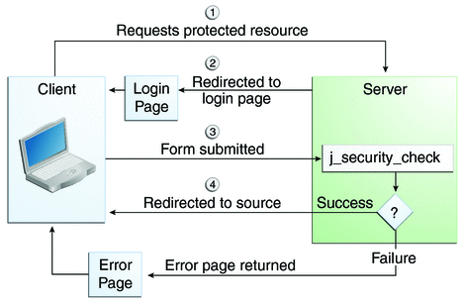
Forms Based Authentication How it Works: - The user submits a login form (e.g., Username and Password). - On successful login, a ticket is created and sent to the client’s browser. - The server uses this ticket to identify and authenticate the user for subsequent requests.

Slide 4
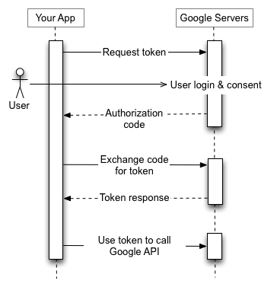
Federation Based Authentication It is used in scenarios where - you want to use a third-party identity provider (such as Google, or a custom identity provider) to authenticate users across different applications. Standards: - SAML (Security Assertion Markup Language): used for enterprise-level app. - OAuth Connect: How it Works often used in conjunction with services like Azure AD, Google

Slide 5
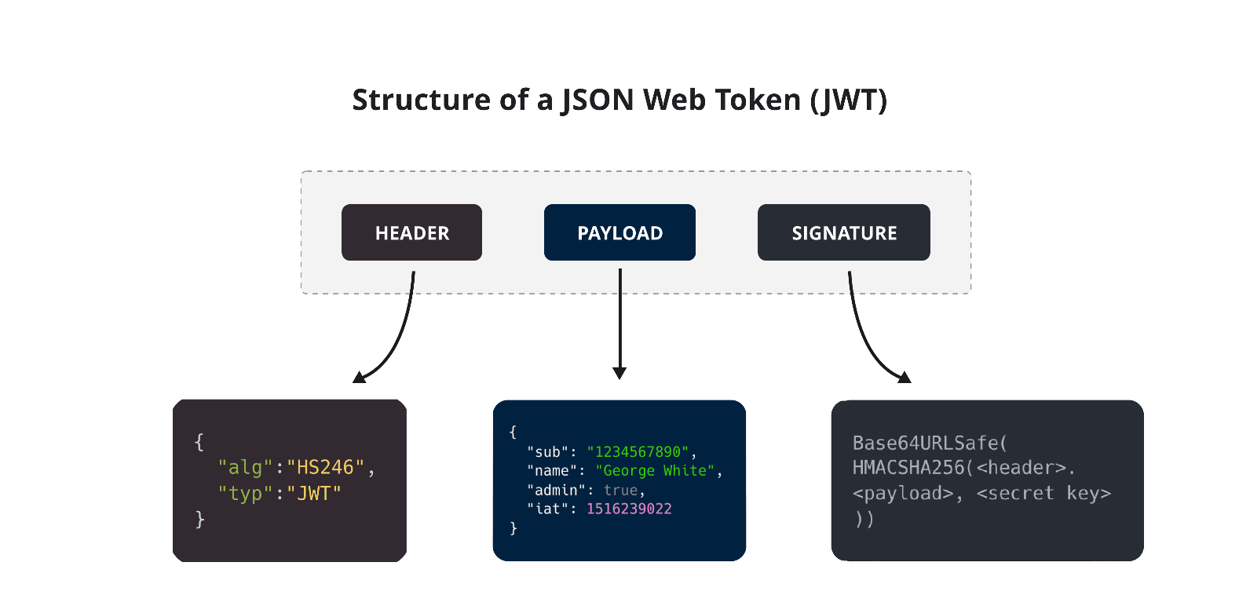
JWT Authentication (Token-based Authentication) - JWT is a compact, URL-safe means of representing claims to be transferred between two parties. - These claims can be digitally signed, making it a secure way to authenticate and transmit information between the client and server. JWT tokens are often used for: - Stateless Authentication - Cross-Origin Authentication - Scalability

Slide 6
When to Use Each? Forms Authentication: Use this for simple, traditional web applications where you control user sessions and want custom login pages. Federation Authentication: Use this for scenarios involving SSO or when you want to delegate authentication to a trusted identity provider (e.g., Azure AD, Google, or an enterprise SSO provider). JWT Authentication: Use this when building modern web APIs, mobile apps, or SPAs where you want a stateless, scalable authentication system.

Slide 7
Authorization In role-based authorization, users are assigned one or more roles, and access to resources is granted or denied based on those roles. Claim-Based Authorization - Claims are pieces of information about the user, such as their email, age, or any other data tied to the user’s identity. - You can authorize users based on these claims.

Slide 8




THANK YOU
(844) 720-6678
info@simplifyhealthcare.com
simplifyhealthcare.com
Simplify Healthcare
U.S.: 600 N Commons Drive, Suite 110, Aurora, IL 60504
India: 401/402, 4th Floor, Pentagon P-2, Magarpatta City, Pune 411013
CONNECT WITH US
LinkedIn
YouTube
X
Instagram

